Slide 1
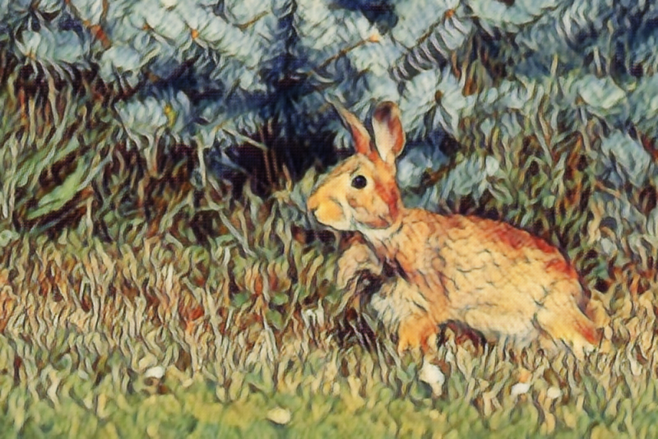
Edge, Patch, AI Art
A Journey of Theory, Videos and Tons of Images!

Slide 2
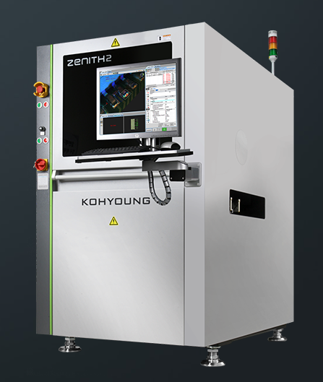
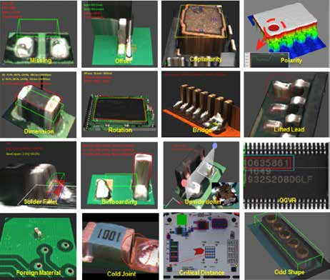
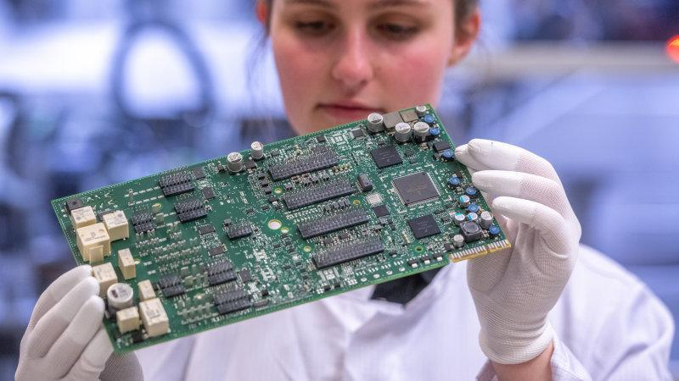
About Me
PhD in Electrical Engineering from UBC
Machine vision engineer in Koh Young Research Canada
automatic optical inspection

Slide 3
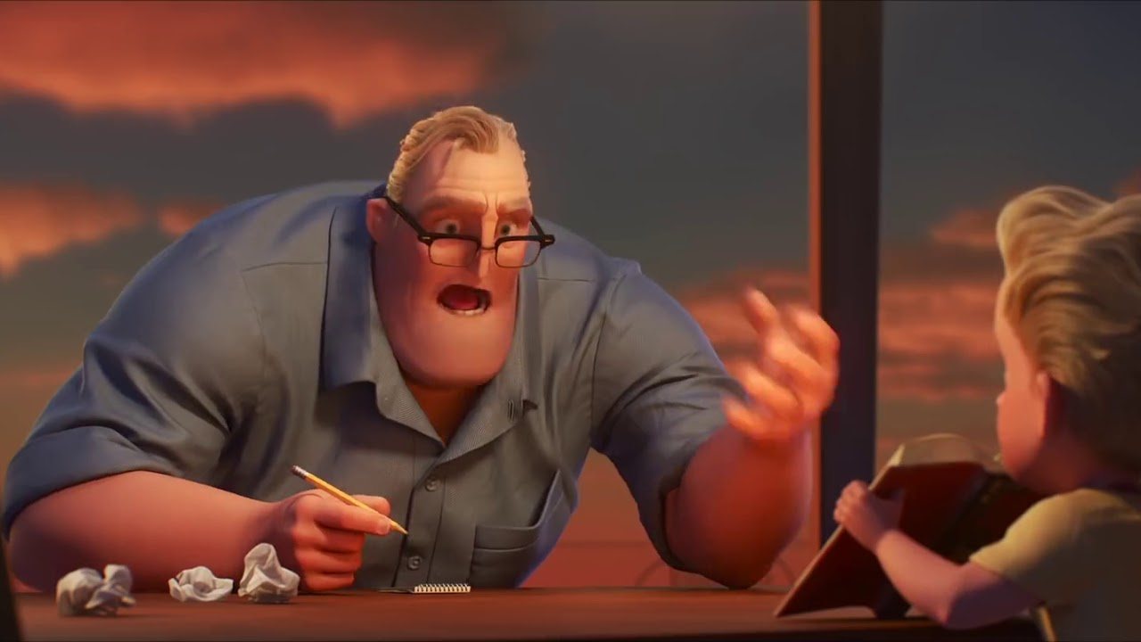
Outline - Part 1
A Gentle Introduction to AI
What is AI
Powered by AI
Machine Learning
Computer Vision
Applications
Mr. Incredible teaching his son math homework
A middle-aged caucasian man holding a pencil talking to a boy, seems agitated

Slide 4
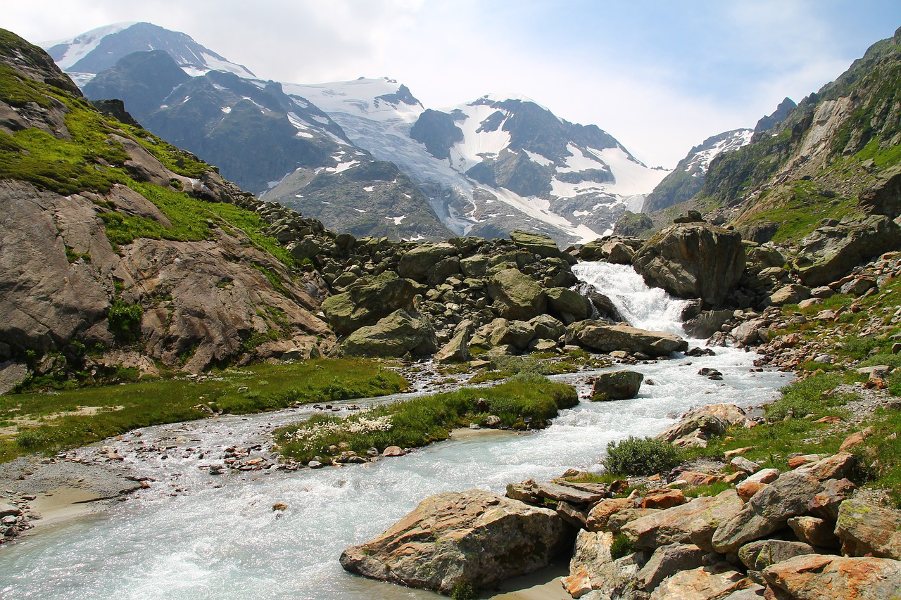
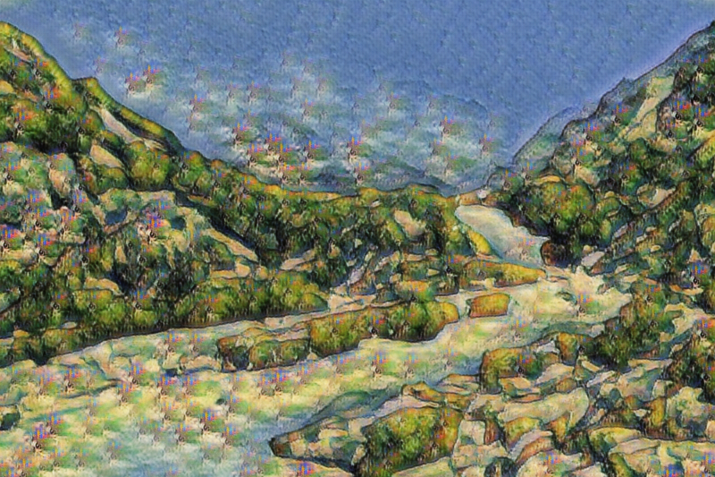
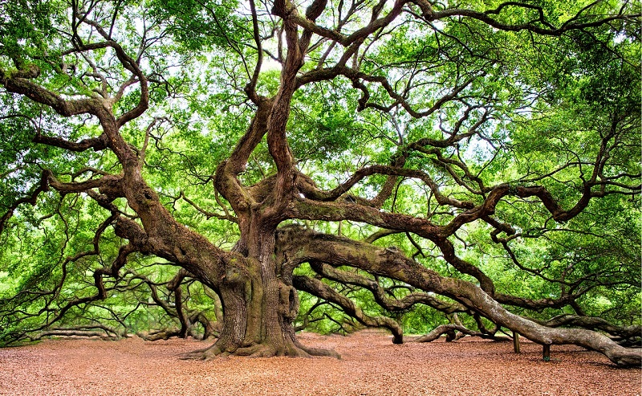
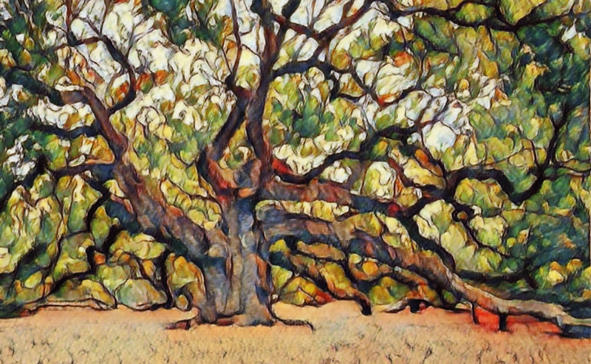
Outline - Part 2
AI Art
Problem Statement
GAN Basics
Regularization
Feature Loss
Edge Loss
Identity Loss
Summary

Slide 5
What is AI??
Hmm... there are a lot of good answers out there ...
Plus, it can be a bit of a philosophcial question...

Slide 6






There seems to be a lot of buzz about AI these days ...
Customer experience
Marketing
Health care
Medical imaging
Insurance claim processing
Digital marketing

Slide 7
What is meant by “Powered by AI”??
Mostly, nowadays, when something is “Powered by AI”, it is built with machine learning and big data.
What is machine learning??
A paradiagm for writing computer algorithm.

Slide 8
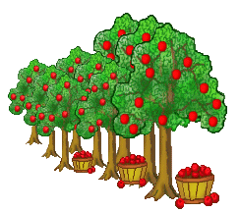
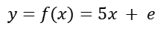
An intuition
Say, we are going to buy some apple trees for their apples,
1 tree gives us 5 apples,
2 trees give us 12 apples,
5 trees give us 24 apples,
20 trees give us 102 apples.
How many apples would 10 trees give us?
the data
the algorithm/function/model
# of apples = 5 times # of trees + variation
$$y=f(x)=5x + e$$

Slide 9
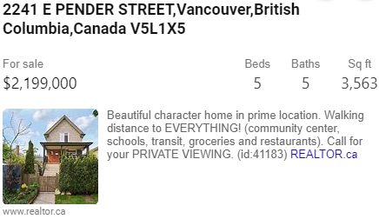
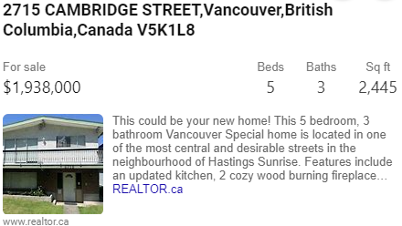
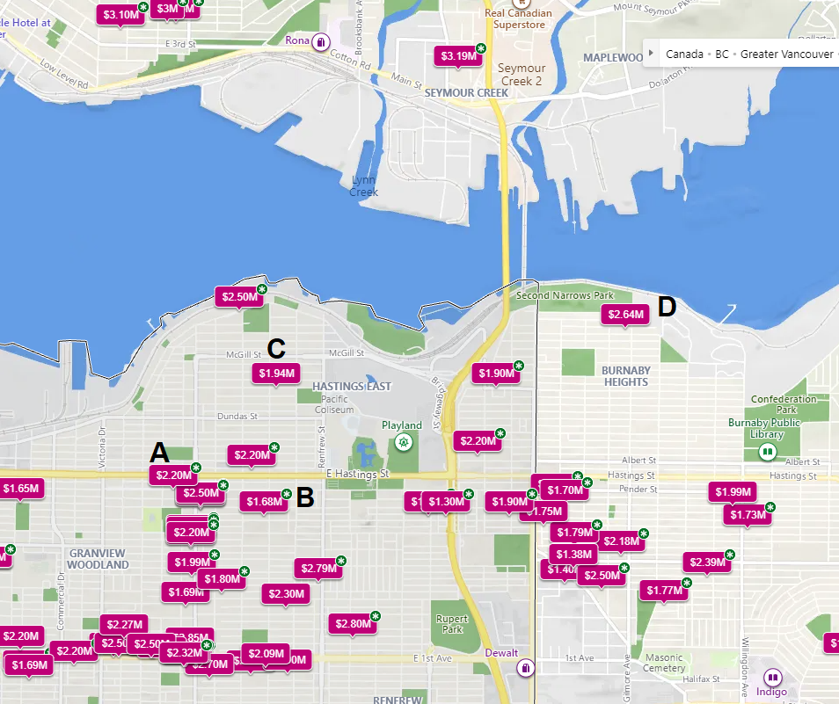
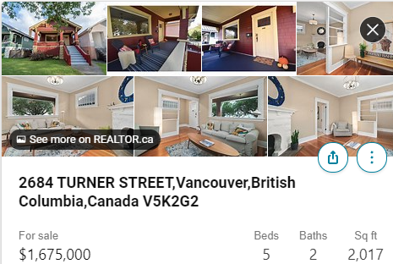
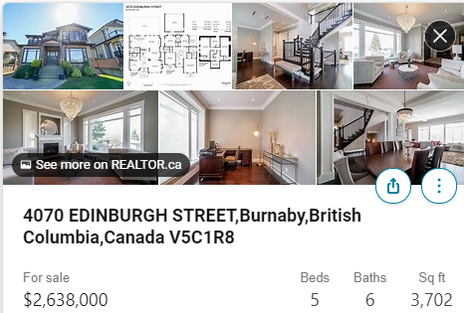
A More Interesting Example
Say, we want to buy a house ...
A
B
C
D

Slide 10
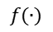
A More Interesting Example
Many more factors to consider
An experienced real-estate agent can still predict the price accurately
Machine learning can also deduce a model for house price
Age
# bathroom
# bedroom
# fireplace
# family room
Livable area
Lot size
Neighbourhood
Location
$$f(∙)$$
Price

Slide 11
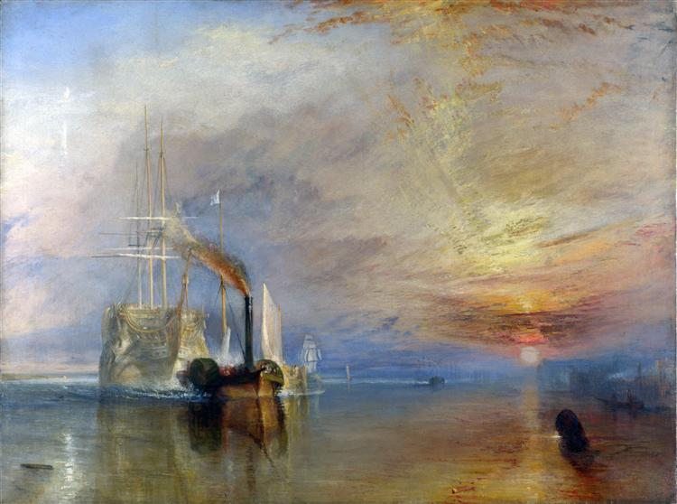
An Example in Computer Vision
Is this a painting by the Dutch painter Rembrandt, or by the English painter Joseph Turner?

Slide 12
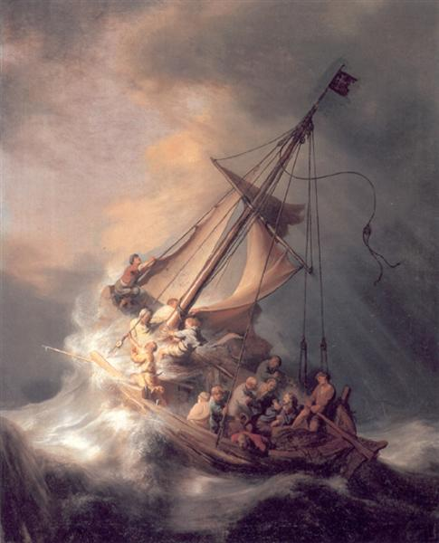
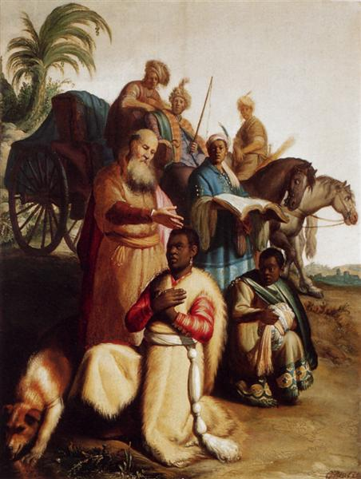
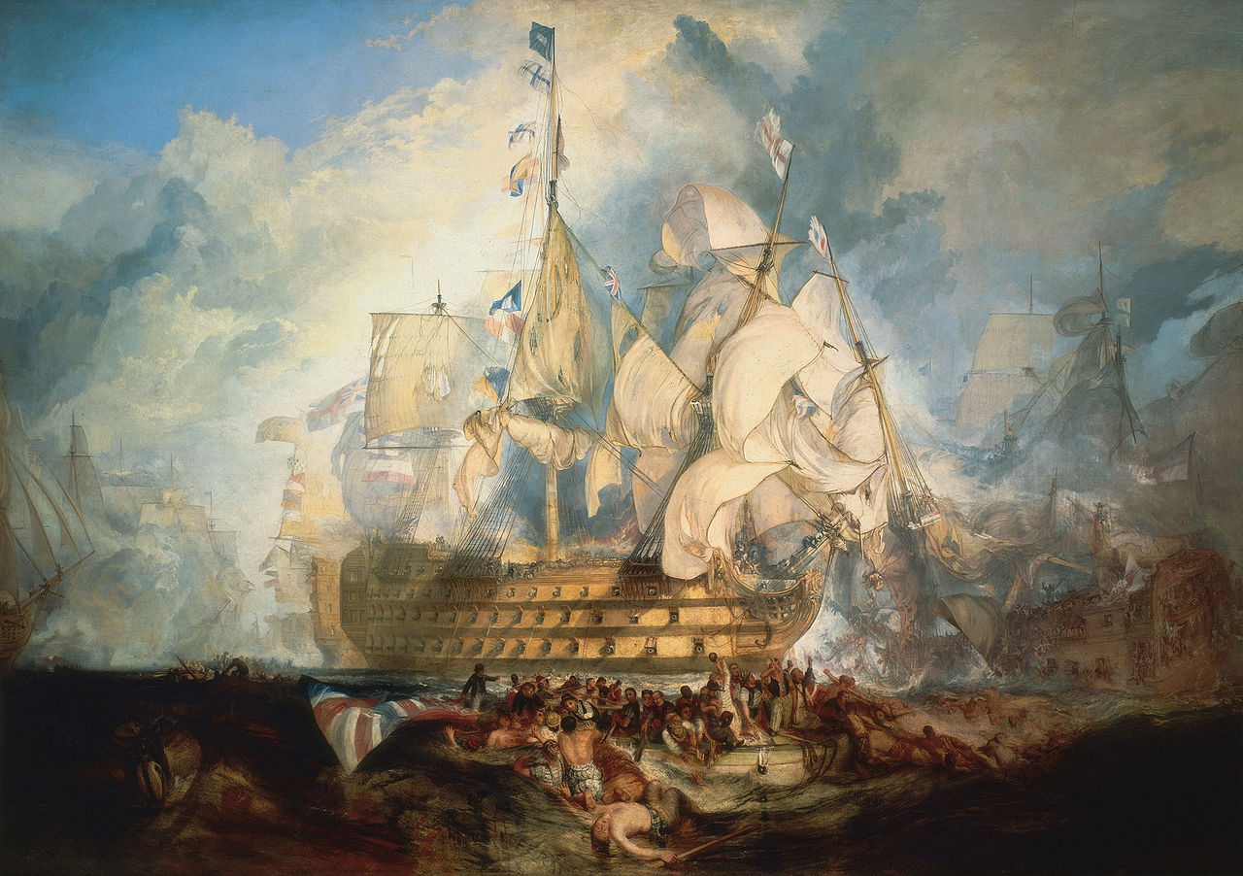
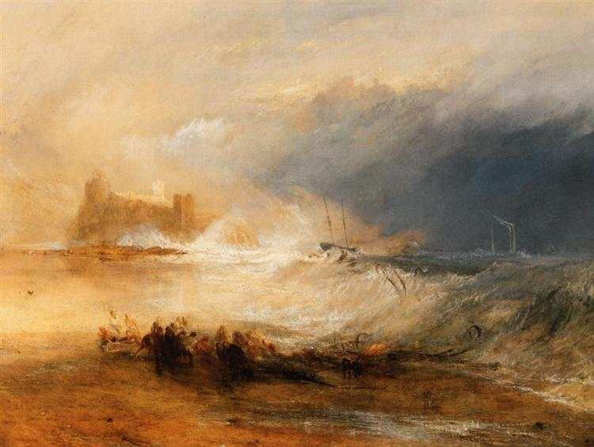
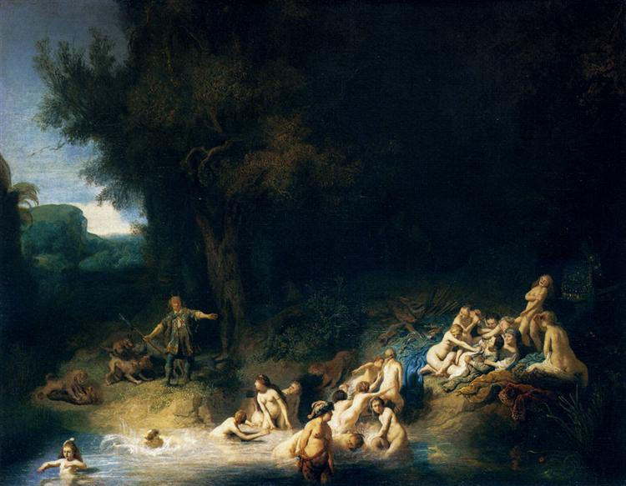
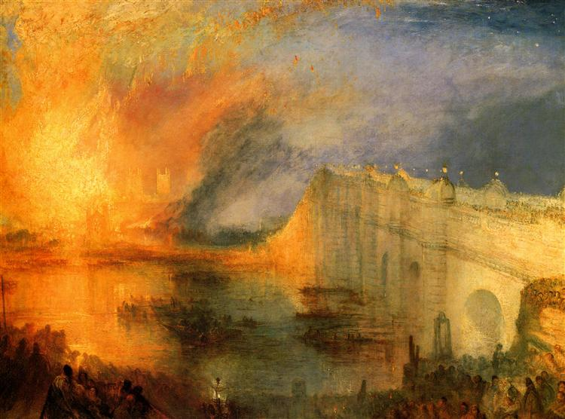
Just give us more examples!
Rembrandt
J. Turner

Slide 13
A trained machine can tell the difference
Rembrandt
$$f(∙)$$
J. Turner

Slide 14
Computer Vision As a Form of AI
CGI
Mr. Incredible teaching his son math homework
Computer Vision
A middle-aged caucasian man holding a pencil talking to a boy, seems agitated

Slide 15
Computer Vision
A form of artificial intelligence
Can be considered as an inverse problem of CGI
Deduce what is in an image
can be abstract concepts

Slide 16
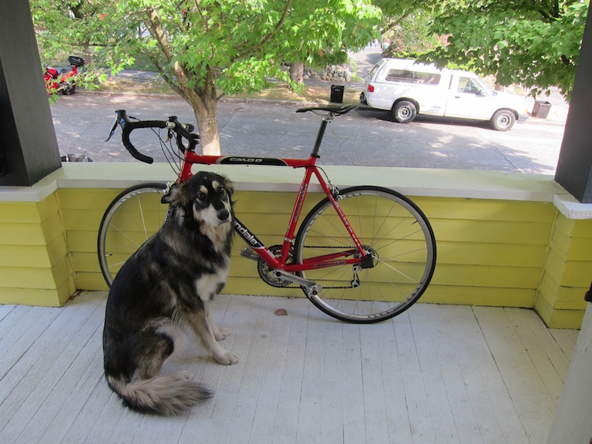

Slide 17
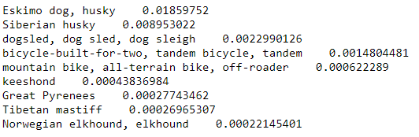
Object Classification - ResNet101
Trained on over 1 million images
ImageNet dataset
Can identify 1000 types of objects

Slide 18
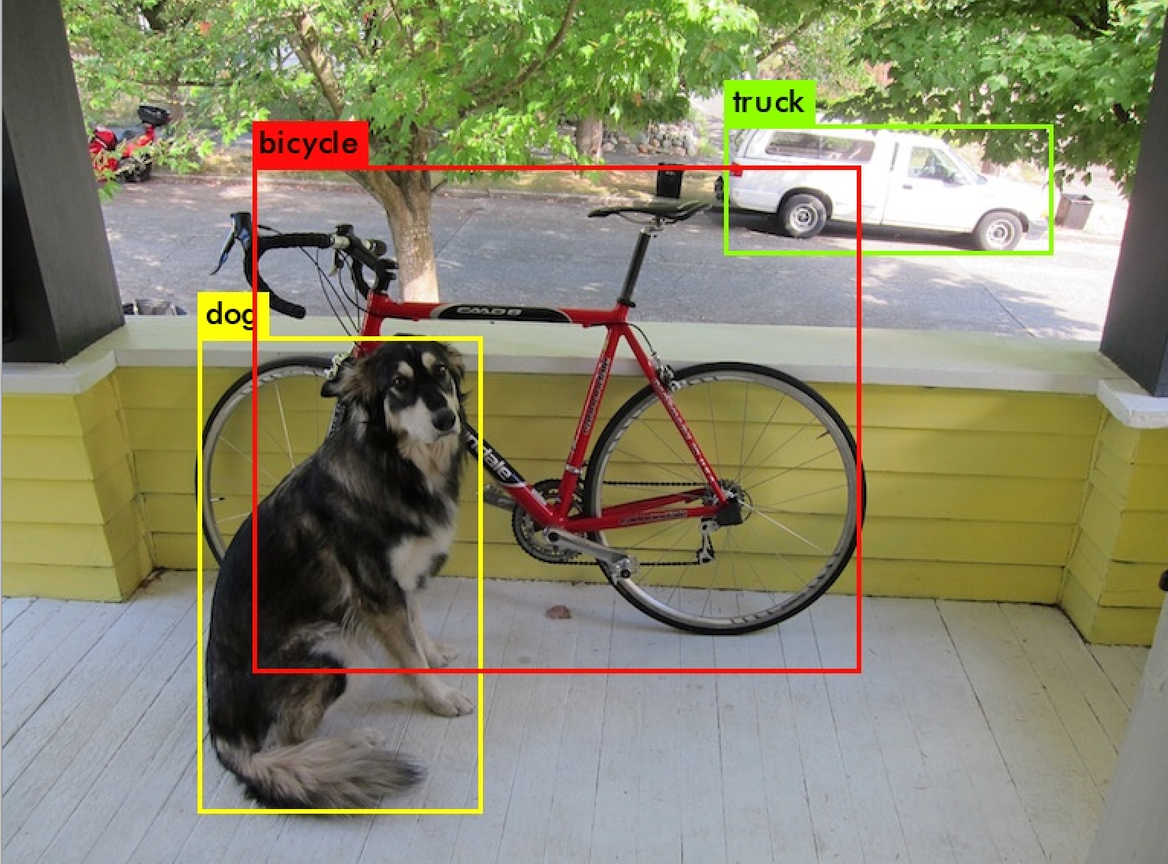
Object Detection - YOLOv3
Trained on over 200 000 images
COCO dataset
Can locate 80 types of objects

Slide 19
Outline - Part 2
AI Art
Problem Statement
Generative Adversarial Network
Regularization
Feature Loss
Edge Loss
Identity Loss
Model Architectures
Conclusions
References

Slide 20
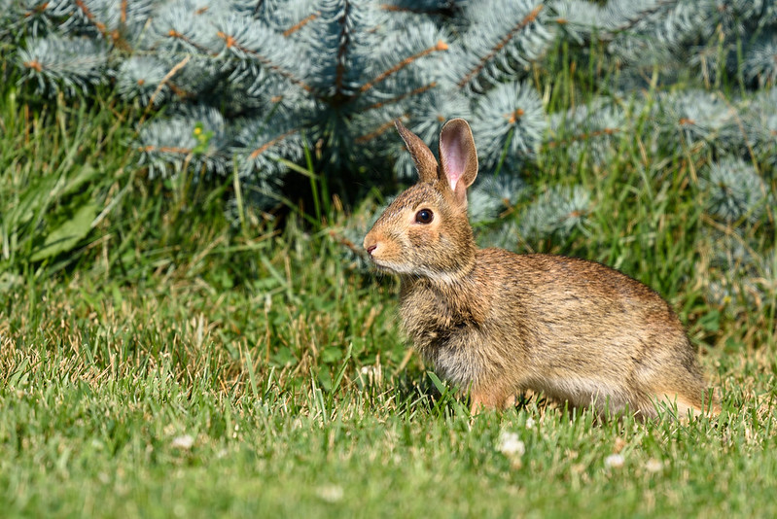
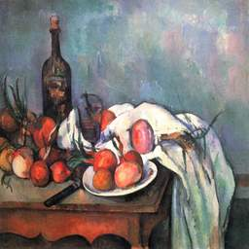
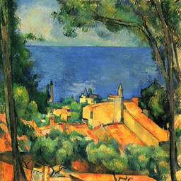
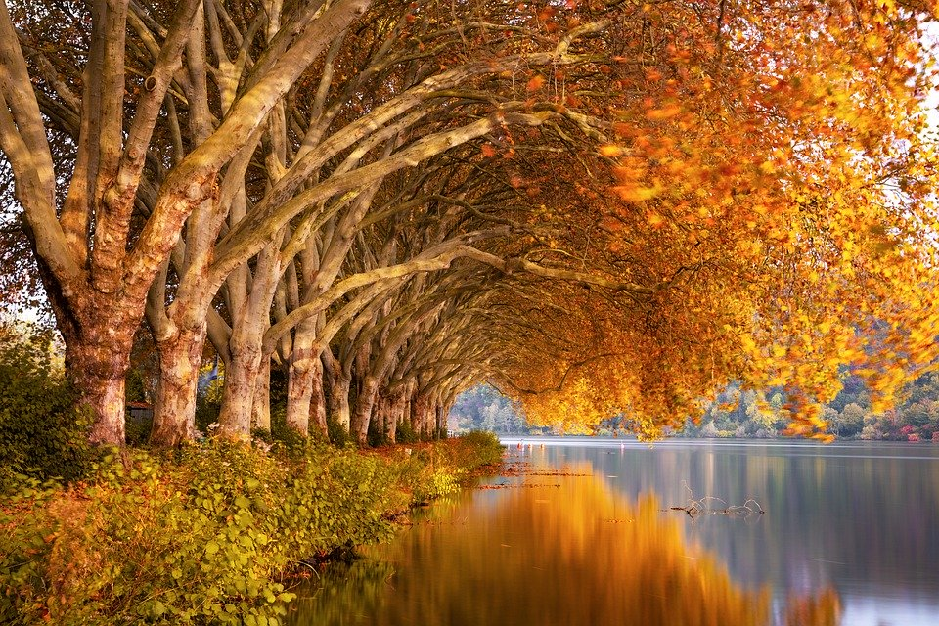
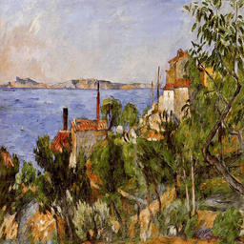
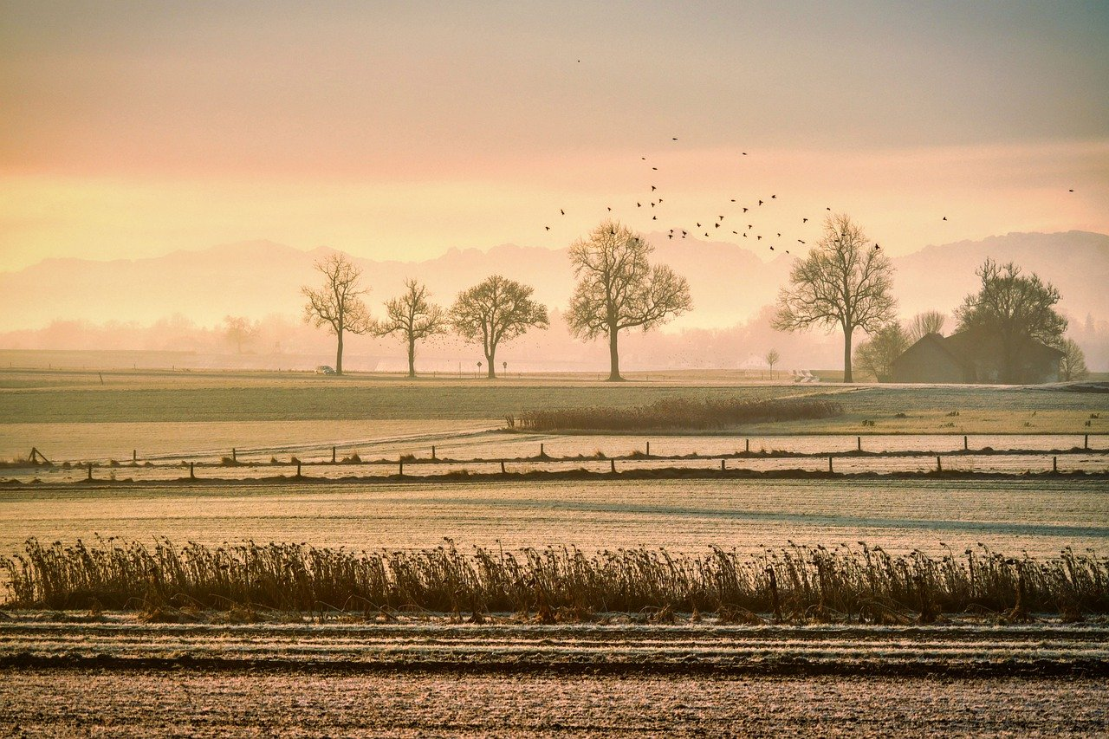
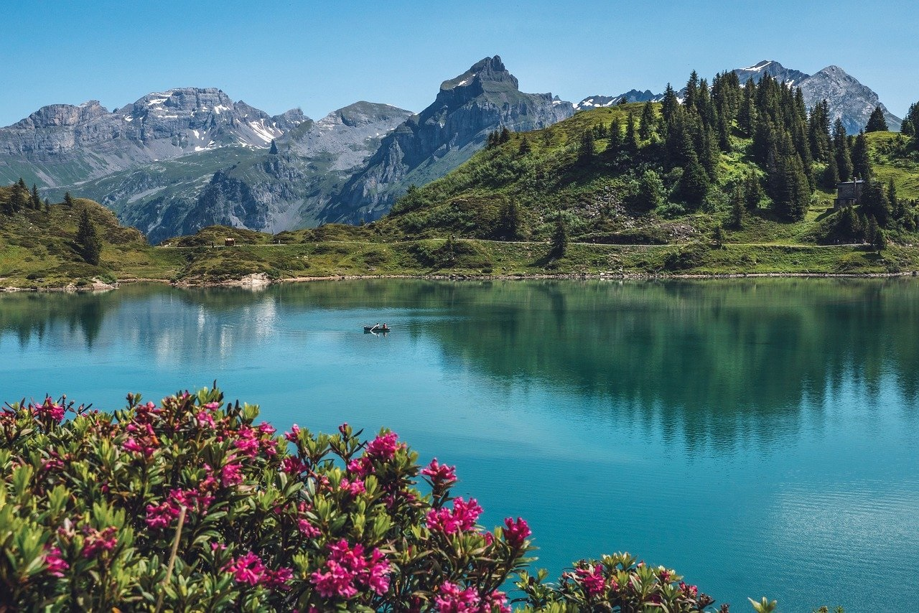
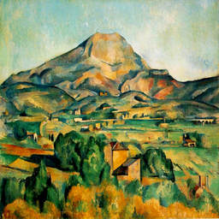
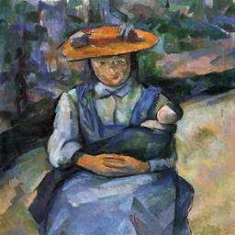
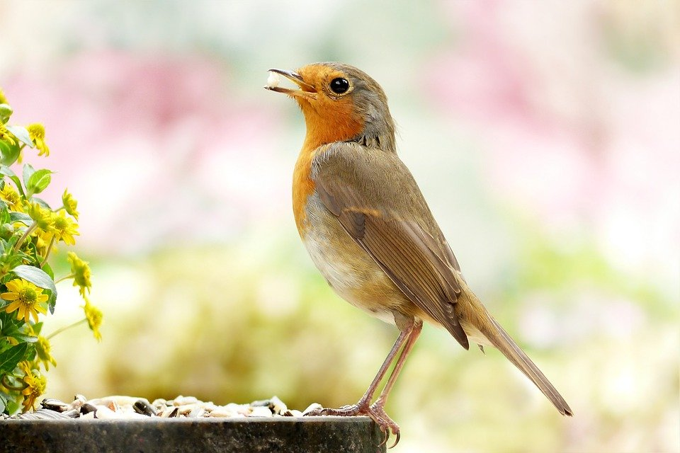
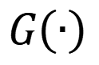
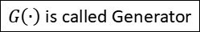

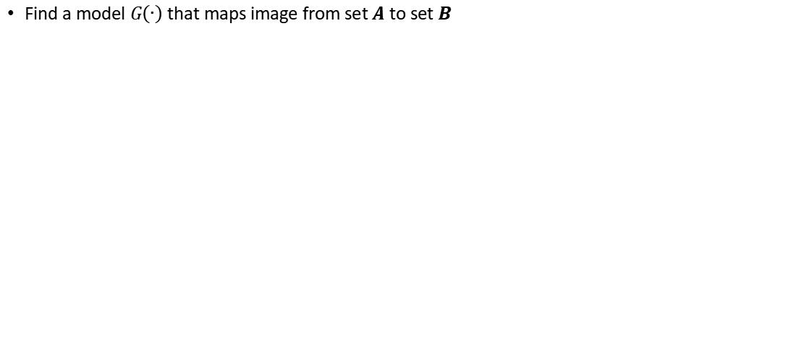

Problem Statement
$G\left(∙\right)$ is called Generator
Paul Cezanne was a 19th century
post-impressionistic French painter
Find a model $G\left(∙\right)$ that maps image from set $A$ to set $B$
$$A$$
$$B$$
$$G\left(∙\right)$$
Paintings created (and could have created) by Cezanne
Photos

Slide 21
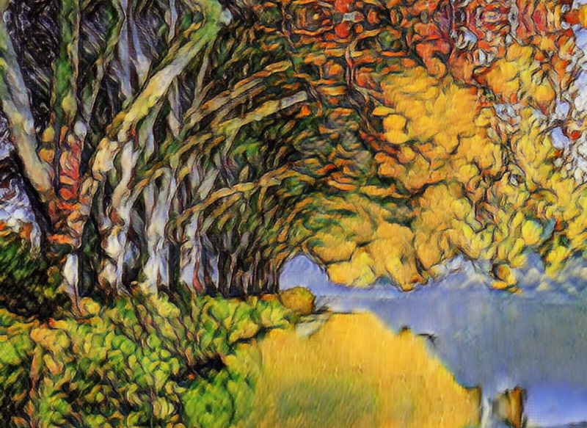
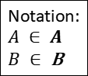
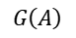
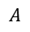

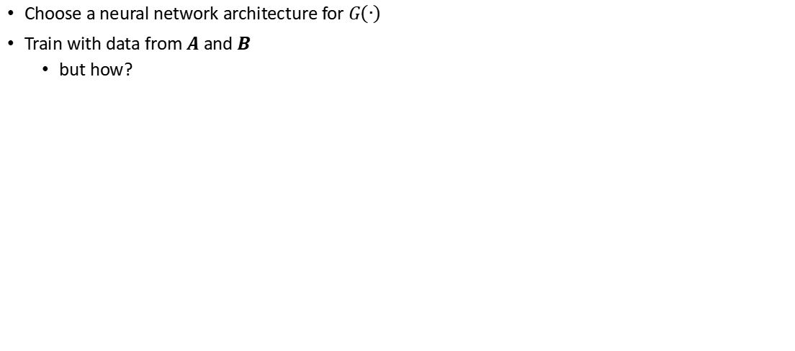
A Machine Learning Approach
Choose a neural network architecture for $G\left(∙\right)$
Train with data from $A$ and $B$
but how?
Notation:
$$A ∈ A$$
$B ∈$B
Extract features from photo
Paint features with learnt style
$$A$$
256 64x64 feature maps
$$G\left(A\right)$$
64 128x128 feature maps
1 256x256 image
$$G\left(∙\right)$$

Slide 22
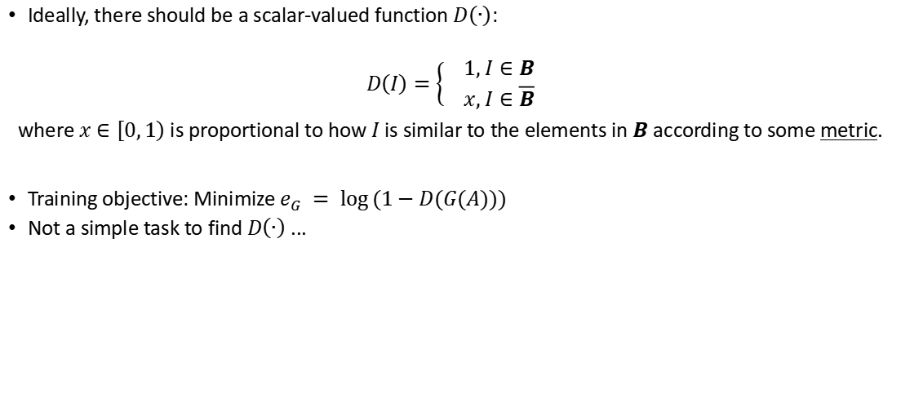

How to train $G\left(∙\right)$?
Ideally, there should be a scalar-valued function $D\left(∙\right)$:
$$D\left(I\right)=\left\{\begin{aligned} 1, I∈B \\ x, I∈\overline{B}\end{aligned}\right.$$
where $x∈\left[0,\left.1\right)\right.$ is proportional to how $I$ is similar to the elements in $B$ according to some metric.
Training objective: Minimize $e_{G} = \log{(1−D(G(A)))}$
Not a simple task to find $D\left(∙\right)$ ...

Slide 23
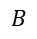
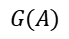
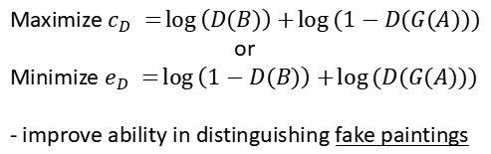
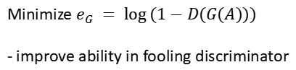






GAN Basics
GAN = Generative Adversarial Nets
A Framework to find $G\left(∙\right)$
We will train both $G(∙)$ and $D(∙)$
$D\left(∙\right)$ is called Discriminator
Update $G(∙)$ and $D(∙)$ alternatingly
$$G(∙)$$
$$B$$
$$D(∙)$$
$$A$$
$$G(A)$$
Iterate
$$\left[0,1\right]$$
$$G(A)$$
Minimize $e_{G} = \log{(1−D(G(A)))}$
- improve ability in fooling discriminator
Maximize $c_{D} =\log\left(D(B)\right)+\log{(1−D(G(A)))}$
or
Minimize $e_{D} =\log\left(1−D(B)\right)+\log{(D(G(A)))}$
- improve ability in distinguishing fake paintings

Slide 24



Benchmark Images

Slide 25

Training Parameters
Parameters
Training dataset: 6287 photos, 525 paintings
Batch size: 1
20 epoches
Constant learning rate
Error functions
$e_{G} = \log{(1−D(G(A)))}$
$e_{D} =\log\left(1−D(B)\right)+\log{(D(G(A)))}$

Slide 26

Videos

Slide 27

Videos

Slide 28



Feature Loss
Intuition: An apple in the photo must be recognizable as an apple in the painting too
An object classifier
a deep learning model that tells us what objects are in an image
a vector-valued function $M\left(∙\right)$
$$M(I) = k, k ∈ R^{n}$$
where $k_{i}$ is the probabily of a specific object is in $I$
Add a penality term to $e_{G}$
$$e_{G} = \log{(1−D(G(A)))}+ α∙{\left\|M\left(A\right)−M\left(G\left(A\right)\right)\right\|}_{L1}$$
$$M\left(A\right)$$
$$M\left(G\left(A\right)\right)$$

Slide 29

Training Parameters
Parameters
Training dataset: 6287 photos, 525 paintings
Batch size: 1
20 epoches
Constant learning rate
Error functions
$e_{G} = \log{(1−D(G(A)))}+ α∙{\left\|M_{1}\left(A\right)−M_{1}\left(G\left(A\right)\right)\right\|}_{L1}, α = 1.0$
or $e_{G} = \log{(1−D(G(A)))}+ α∙{\left\|M_{2}\left(A\right)−M_{2}\left(G\left(A\right)\right)\right\|}_{L1}, α = 5.0$
$e_{D} =\log\left(1−D(B)\right)+\log{(D(G(A)))}$

Slide 30

Videos

Slide 31

Videos

Slide 32

Edge Loss
Intuition: The outline in the photo should be similar to the outline in the painting
An edge detector
a deep learning model that tells us which pixel is an edge
a vector(matrix)-valued function $R\left(∙\right)$
$$R(I) = h, h ∈ R^{n×n}$$
$$h_{i,j}∈\left[0,1\right]$$
where $h_{i,j}$ is the probablity of pixel $I(i,j)$ is an edge
Add a penality term to $e_{G}$
$e_{G} = \log{(1−D(G(A)))}+ β∙{\left\|R\left(A\right)−R\left(G\left(A\right)\right)\right\|}_{L1}$

Slide 33

Identity Loss
Intuition: If we input a painting to the generator, it should output the same painting
Mathematically,
$G\left(B\right)= B$
Add a penality term to $e_{G}$
$e_{G} = \log{(1−D(G(A)))}+ {\left\|G\left(B\right)−B\right\|}_{L1}$

Slide 34

Training Parameters
Parameters
Training dataset: 6287 photos, 525 paintings
Batch size: 1
20 epoches
Constant learning rate
Error functions
$e_{G} = \log{(1−D(G(A)))}+ β∙{\left\|R_{5}\left(A\right)−R_{5}\left(G\left(A\right)\right)\right\|}_{L1}+ γ∙{\left\|G\left(B\right)−B\right\|}_{L1},$
$$β = 3.0, γ = 0.5$$
$e_{D} =\log\left(1−D(B)\right)+\log{(D(G(A)))}$

Slide 35

Videos

Slide 36

Gallery
Edge loss - iteration 94000 th

Slide 37

Gallery
Edge loss + Identity loss - iteration 90000 th

Slide 38
Gallery
Edge loss + Identity loss - iteration 138000 th

Slide 39

Gallery
Edge loss + Identity loss - iteration 162050 th

Slide 40

Gallery
Edge loss + Identity loss - iteration 165450 th

Slide 41


Gallery
Feature loss (final layer) - iteration 168000 th

Slide 42


Gallery
Edge loss + Identity loss - iteration 165250 th

Slide 43


Gallery
Edge loss + Identity loss - iteration 163550 th
(Color enhanced)

Slide 44
State of the Art GAN
https://www.youtube.com/watch?v=9QuDh3W3lOY&t=5s

Slide 45
Summary
What is “Powered-by-AI”
An intuition about machine learning
Computer vision as a form of AI
Generative adversarial network basics
Application in arts

Slide 46
Contact Me
mandeleung@gmail.com

